Slide 1
4-BIT ODD PARITY GEN
GROUP-22: Amogh Garg and Yash Jindal

Slide 2
Parity Generator
Majority of modern communication is Digital in nature i.e., it is a combination of 1’s and 0’s. The digital data is transmitted either through wires (in case of wired communication) or wireless. Even in an advanced mode of communication, there will be errors while transmitting data (due to noise).The simplest of errors is corruption of a bit i.e., a 1 may be transmitted as a 0 or vice-versa. To confirm whether the received data is the intended data or not, we should be able to detect errors at the receiver. This is done by generating a Parity Bit.
Introduction

Slide 3
PARITY BIT AND GENERATOR
PARITY BIT
PARITY GENERATOR
The parity generating technique is one of the most widely used error detection techniques for the data transmission. In digital systems, when binary data is transmitted and processed, data may be subjected to noise so that such noise can alter 0s (of data bits) to 1s and 1s to 0s.
Hence, a Parity Bit is added to the word containing data in order to make number of 1s either even or odd. The message containing the data bits along with parity bit is transmitted from transmitter to the receiver.
At the receiving end, the number of 1s in the message is counted and if it doesn’t match with the transmitted one, it means there is an error in the data. Thus, the Parity Bit it is used to detect errors, during the transmission of binary data.
A Parity Generator is a combinational logic circuit that generates the parity bit in the transmitter. On the other hand, a circuit that checks the parity in the receiver is called Parity Checker. A combined circuit or device of parity generators and parity checkers are commonly used in digital systems to detect the single bit errors in the transmitted data.
Here we will talk only about 4-Bit Odd Parity Generator.

Slide 4
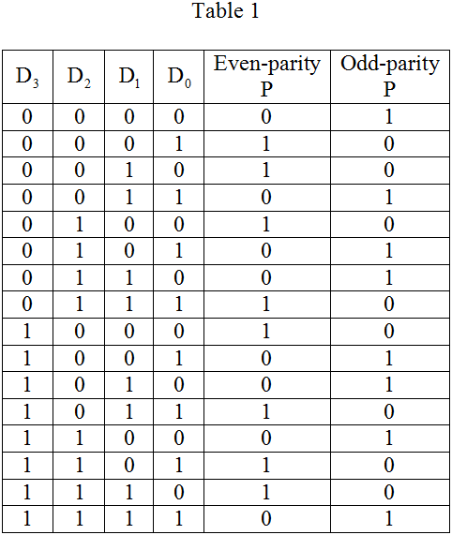
4-Bit Odd Parity Generator
The sum of the data bits and parity bits can be even or odd. In even parity, the added parity bit will make the total number of 1s an even number, whereas in odd parity, the added parity bit will make the total number of 1s an odd number. If we have 4 bits, then it becomes a 4-bit odd parity generator. Now the output odd parity bit would be decided on the basis of 4 input bits, namely D3, D2, D1, and D0.

Slide 5
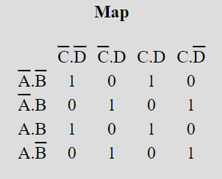

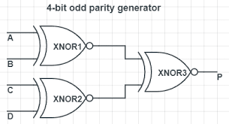
LOGIC AND DESIGN
So if we have 4-Bit inputs A,B,C,D then K-Map will look like-
OR
On simplifying:
Y= NOT(((A XOR B)XOR C) XOR D)

Slide 6
ADVANTAGES AND DRAWBACKS
The advantage is its simplicity and ease of use. But along with these, there are few disadvantages also which are as follows:
If there are errors in more than 1-bit then parity checker won’t be able to detect it.
No way to find which bit is corrupted.

Slide 7
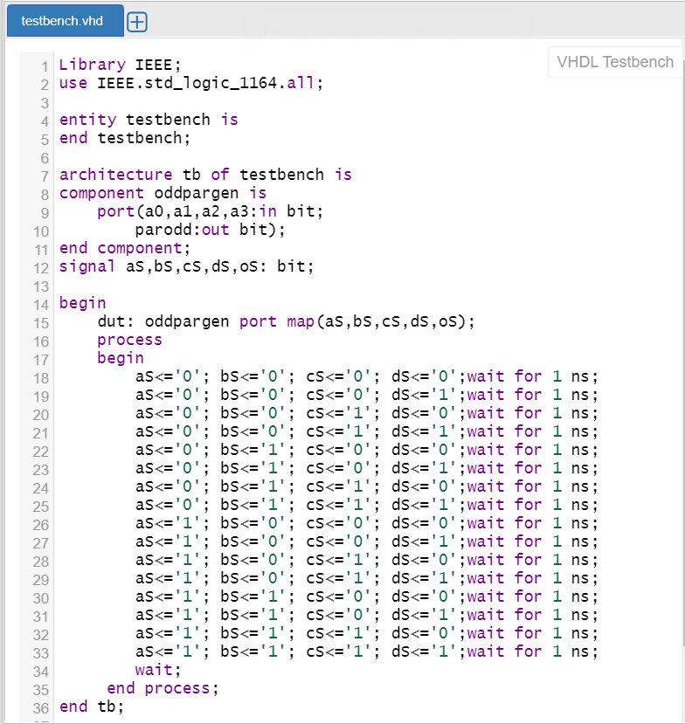
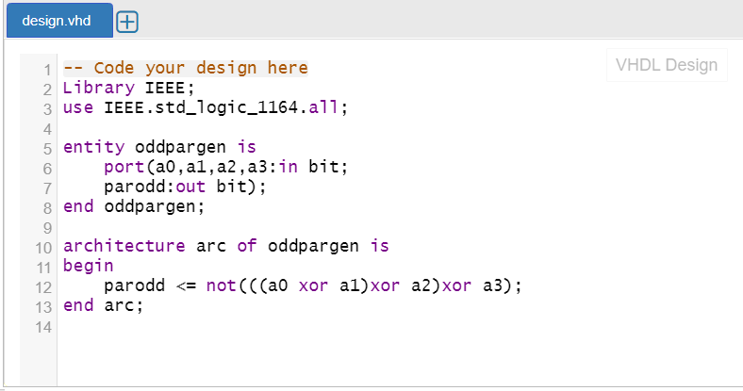
VHDL CODE

Slide 8
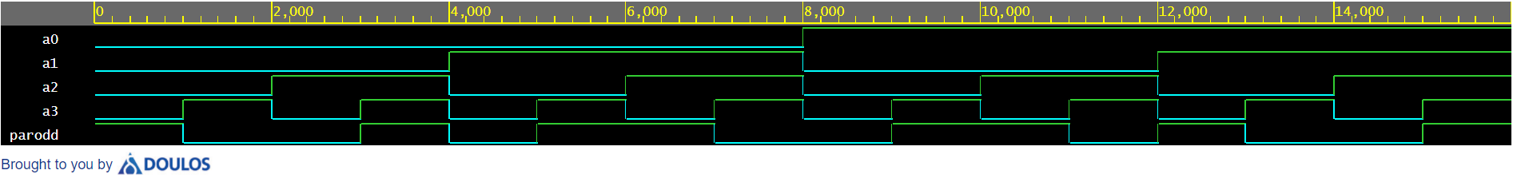
OUTPUT WAVEFORM
From the waveform it is clearly visible that “parodd” is 1 only when the sum of number of 1’s in “a0”, “a1”, “a2” and “a3” is even so as to make the total number of 1’s odd.
Therefore 4-Bit Odd Parity Generator is successfully implemented using VHDL.

Slide 9
THANK YOU!

